Slide 1


Optimization of Finished goods
Dispatches from Plant
Rakesh Bhattacharjee
Roll No. -*******
********@ds.study.iitm.ac.in

Slide 2
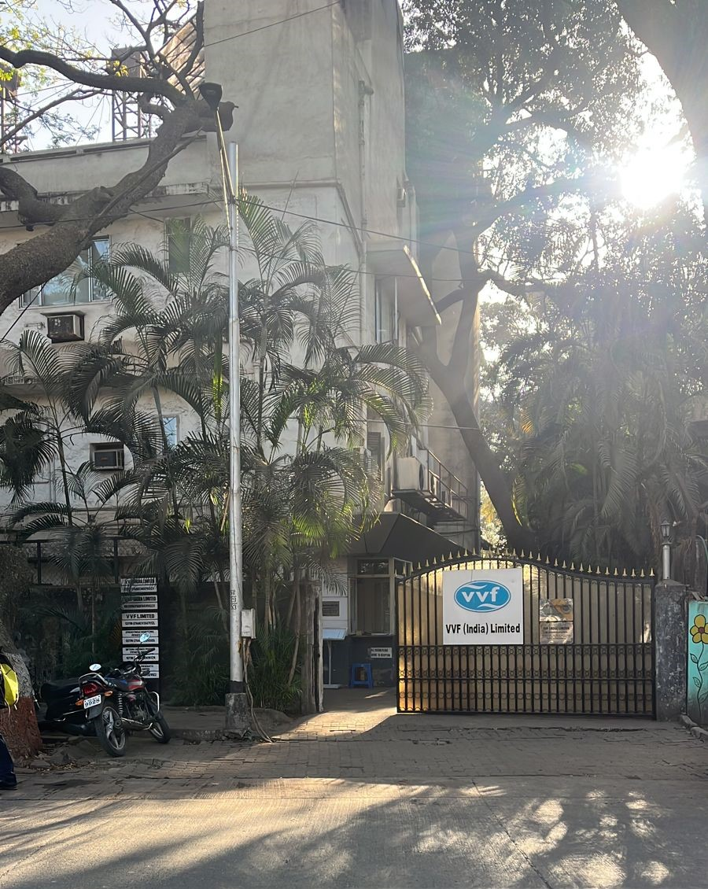

OVERVIEW
VVF (India) Ltd is a Leading Oleo Chemicals company situated in mumbai .
Storing a huge quantity at the plant is not feasible for both the customer and manufacturer.
Prompt dispatch of material is essential to avoid space constraint, maintain lean inventory, and ensure timely delivery of materials.
The company presently uses a Transport Management System (TMS) to track outbound vehicle movement.
Total of 14 steps in TMS with various department roles defined: Security,Logistics, Quality Control, Weigh Bridge, Tank Farm, and Excise team.
Problem Statement
The disparity & inconsistency in dispatches are increasing.
Vehicles/tankers are taking longer than expected time as there is no standard Gate In- & Gate out for vehicle/tankers.
Detention charges are rising.
Customer complaints are increasing.

Slide 3




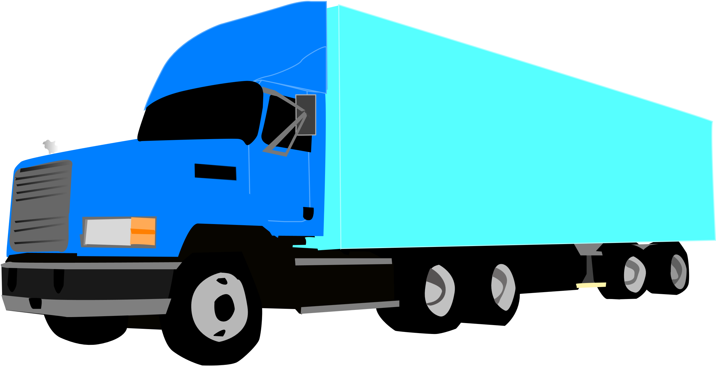
OBJECTIVES
OBJECTIVE 2
OBJECTIVE 4
Assess the impact of detention charges due to the delay in releasing the vehicle/tanker from the plant.
Utilize the present transport management system to track outbound vehicle movement with assigned roles for concerned departments.
OBJECTIVE 1
OBJECTIVE 3
Analyse the reasons for the delay in dispatches and modify existing SOPs if required.
Ensure smooth operation, reduced error, and optimized dispatch process at the plant.

Slide 4



DATA & APPROACH
Mixed-method approach used to identify reasons behind delays in dispatching goods from the plant and finding solutions to reduce turnaround time of vehicles/tankers, minimize detention charges, and ensure faster dispatch of goods.
Qualitative data gathered through Supply Chain Manager to understand operational structure of the plant, SOPs, and potential causes of disruptions.
Qualitative data provided insights into materials and SKU types, their characteristics, and required movements, as well as documents needed during vehicle movement.
Quantitative data collected from SAP, containing 17 columns such as material description, vehicle details, and overall time spent by vehicle in the plant.

Slide 5

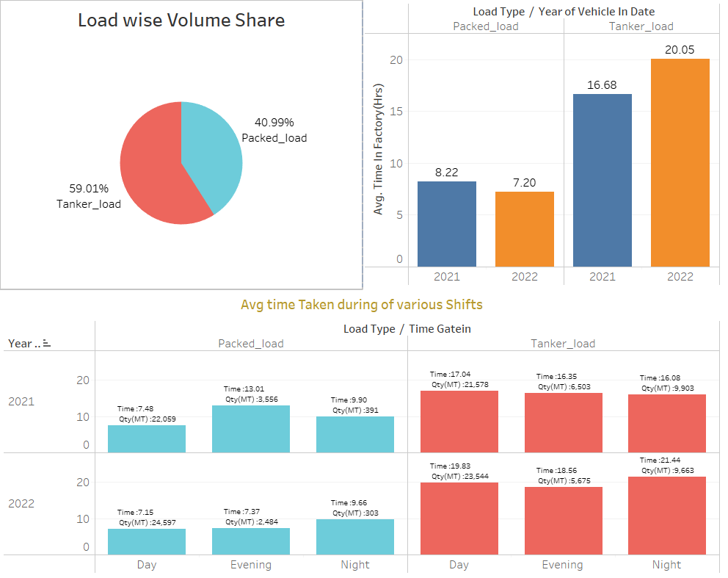
Analysis & Findings :
Bulk pack is the major volume contributor.
Average dispatch time for bulk loading has significantly increased by 21%,while the dispatch time for packed material has decreased.
Average dispatch time increased in all three Phases for bulk load.

Slide 6
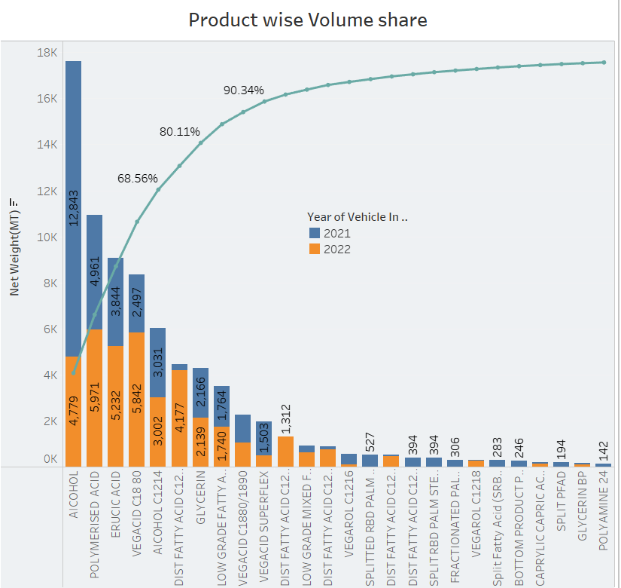
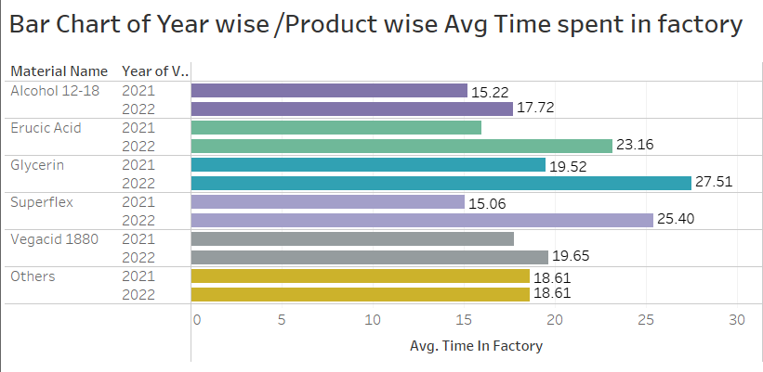
Analysis & Findings :
Top five products contributing 69% of business volume – Alcohol, Vegacid,Erucic Acid, Glycerin & Superflex .
Average dispatch Time significantly decreased for all the major five products .

Slide 7
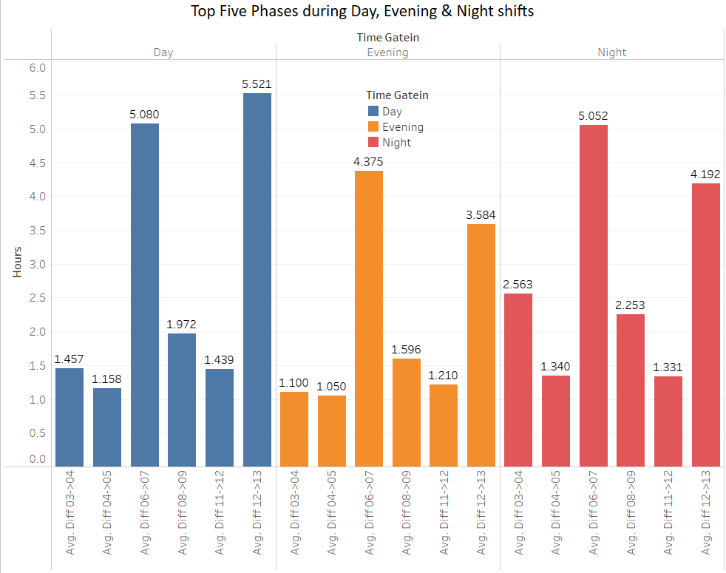
Analysis & Findings :
Top six processes which are consuming almost 89% of total time spent by a vehicle for Bulk Loading.
Operation efficiency is decreasing during both day and night shifts for top six phases.

Slide 8
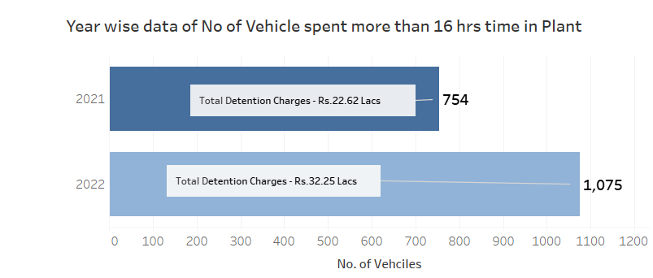
Analysis & Findings :
Exceptional increase of vehicle rejection & Detention charges

Slide 9
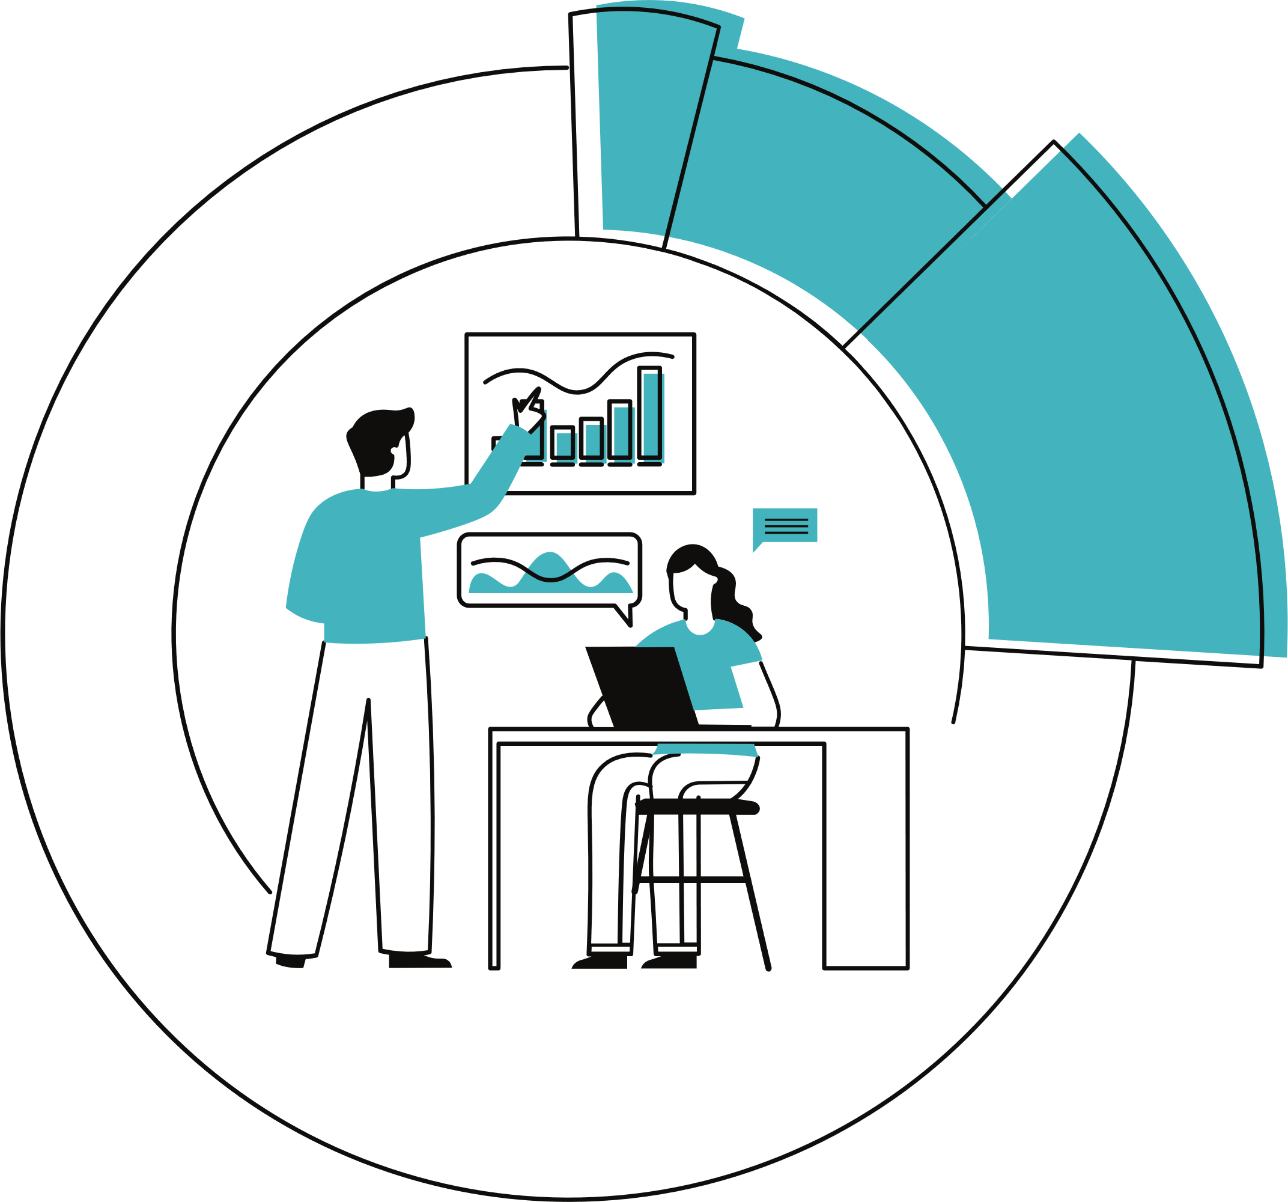
Important Observations
Bulk pack is the major volume contributor & the average dispatch time for bulk loading has significantly increased by 21%, while the dispatch time for packed material has decreased slightly, suggesting inefficiencies in the loading process that need to be addressed.
Business volume increased by 3.5% YoY, but total hours spent by vehicles inside the plant increased by 15%, indicating inefficiencies in plant operations.
The weekday-wise dispatch efficiencies for bulk materials have decreased significantly year on year, likely due to increased dispatch times during both day and night shifts.
The operational capabilities during both day and night shifts have dropped significantly, particularly in phases (06 -07). There are unusual spikes in the time Total Time taken from Tanker weighment to completion of Material Loading time is significantly high during Day and night shift and (phase 12-13) is high during day shift entries .
The average dispatch time for high-margin has significantly increased, while the average dispatch time for low-margin products has remained unchanged despite a 50% increase in volume.
Average time for phases 3-4 increased significantly for all major products, and for phase 06-07, the overall average time increased except for alcohol products. There are also spikes in phase (08-09) and phase (12-13).
Total detention charge paid to transporters increased by 43% YoY, adding to operational costs.
Exceptional increase of 46% YoY in vehicle rejection, putting an additional burden on plant operation.

Slide 10
General Recommendations
Hire additional workforce to meet demand and streamline workflow.
Digitize processes for real-time information flow and increased efficiency.
Invest in modern instruments for quality department and tank farm to improve quality and prevent delays.
Improve efficiency during day and night shifts with modern technology.
Prioritize high-margin products for timely dispatch and improved profitability.
Deprioritize low-margin products depending on traffic in the plant.
Save on detention charges by taking a holistic approach to improvement.
Train employees and transporters to improve coordination, efficiency, and safety protocols.

Slide 11



Security :
JANUARY
Deploy additional security manpower for document checking
Digitalize the checking process for real-time verification.
05
Quality Control :
FEBRUARY
Deploy additional manpower for efficient tanker cleaning
Ensure proper information flow from security to QC
Invest in advanced instruments for faster sample analysis
Prioritize high-value products for sample analysis
04
TankFarm :
03
Implement systematic tank allocation and discharge management
Install advanced instruments for increased discharge capacity
Implement real-time monitoring system for better visibility
MARCH
MARCH
Dispatch :
02
Digitize entire dispatch process for efficiency
Replace hard copy quality reports with automatic reports
Accept digital lorry receipts to reduce paperwork
MARCH
Key action Areas
Logistics :
01
Educate & train the transporters on the vehicle requirements & SOP’s and vehicles and ask them to please fit vehicles only for avoid future rejections.
provide training to drivers to ensure they understand safe driving practices and the importance of maintaining the vehicle. This training can include topics such as proper loading and unloading procedures, safe driving practices, and vehicle maintenance.
Charge fine to Transporter to avoid rejection due to faulty vehicles.
FEBRUARY

Slide 12
THANK YOU

